Slide 1
Power Laws
Scale-Free Networks

Slide 2
What Is a Power Law?

Slide 3
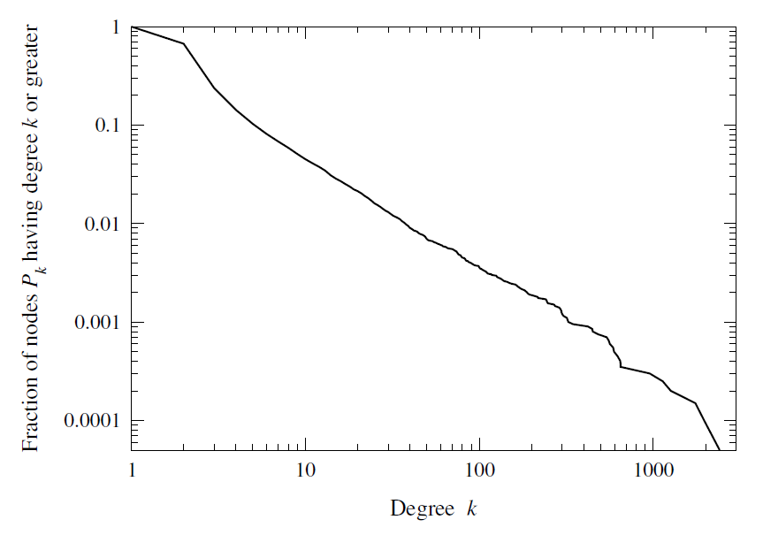
Degree Distribution in Real-World Networks
Cumulative degree distribution on the Internet
The curve on logarithmic scales is close to a straight line.

Slide 4

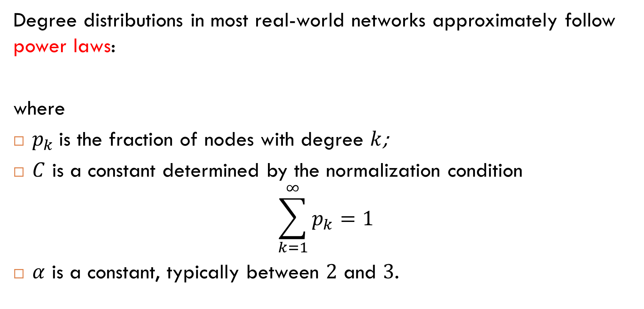
Main Observation
Degree distributions in most real-world networks approximately follow power laws:
where
$p_{k}$ is the fraction of nodes with degree $k$;
$C$ is a constant determined by the normalization condition
$$\sum_{k=1}^{∞}{p_{k}}=1$$
$α$ is a constant, typically between $2$ and $3$.
$$p_{k}=Ck^{−α}$$

Slide 5
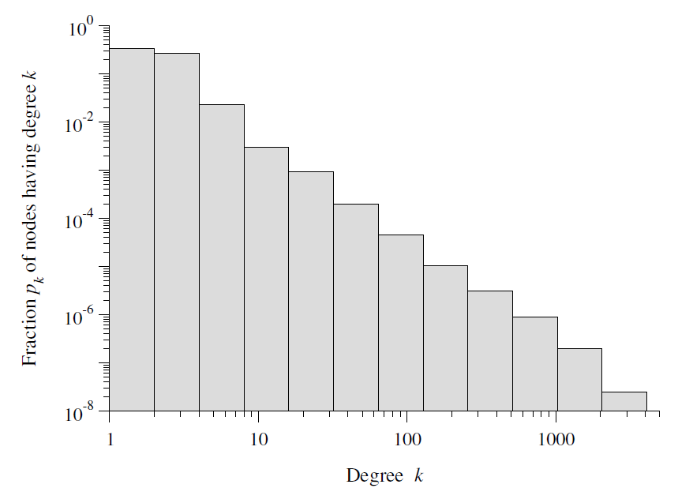

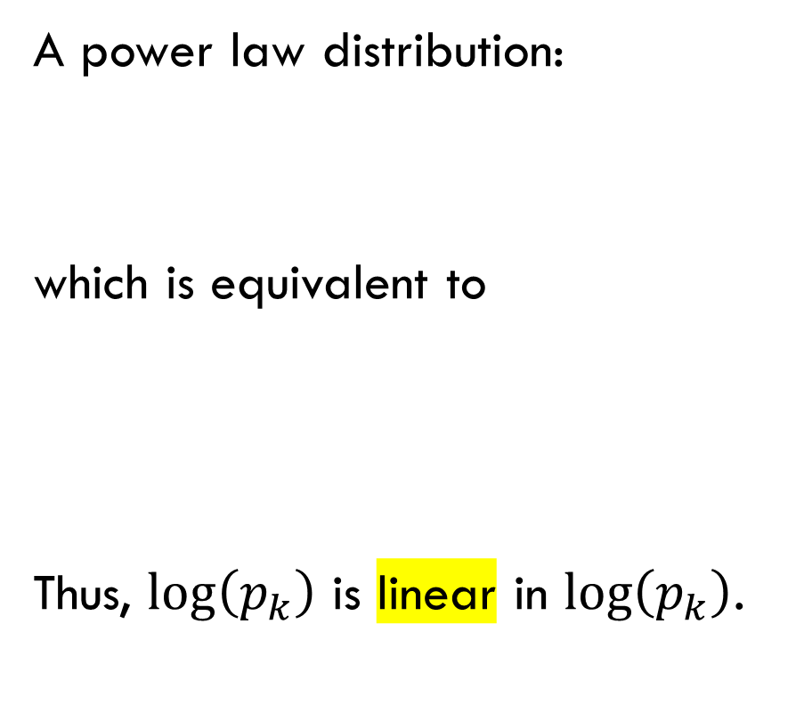

Why a Straight Line?
A power law distribution:
which is equivalent to
Thus, $\log\left(p_{k}\right)$ is linear in $\log\left(p_{k}\right)$.
$$p_{k}=Ck^{−α}$$
$$\log\left(p_{k}\right)⁡=c−α\log{k}$$

Slide 6
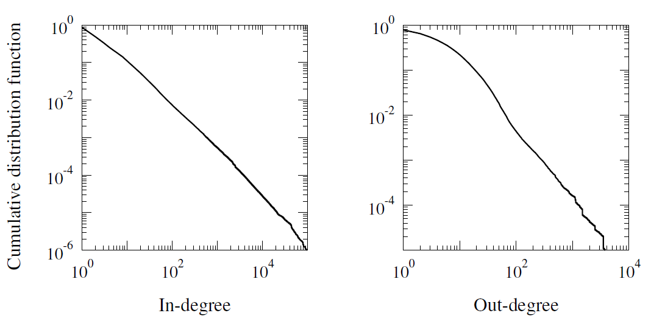
Cumulative Degree Distribution of the Web

Slide 7
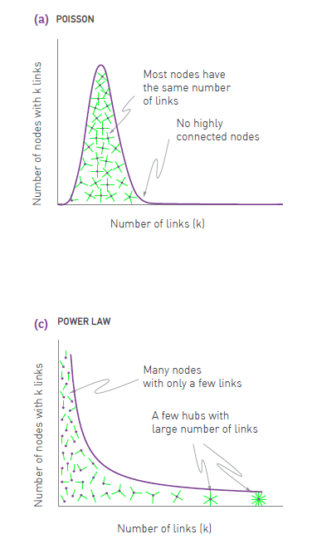
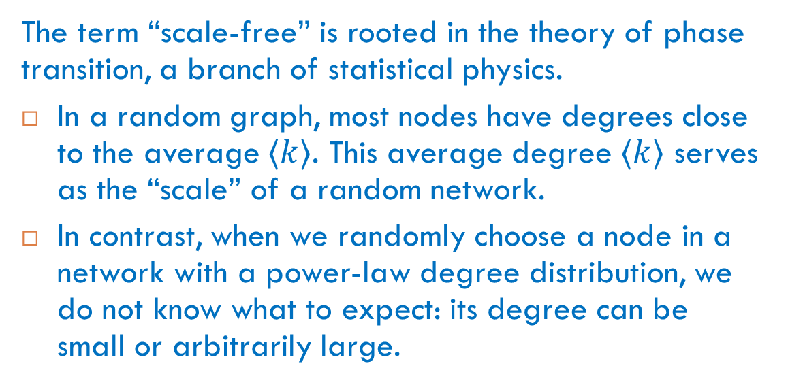
Terminology
Networks with power-law degree distributions are often called scale-free networks.
The term “scale-free” is rooted in the theory of phase transition, a branch of statistical physics.
In a random graph, most nodes have degrees close to the average $⟨k⟩$. This average degree $⟨k⟩$ serves as the “scale” of a random network.
In contrast, when we randomly choose a node in a network with a power-law degree distribution, we do not know what to expect: its degree can be small or arbitrarily large.

Slide 8
Examples of Power Laws
Not Just in Networks

Slide 9
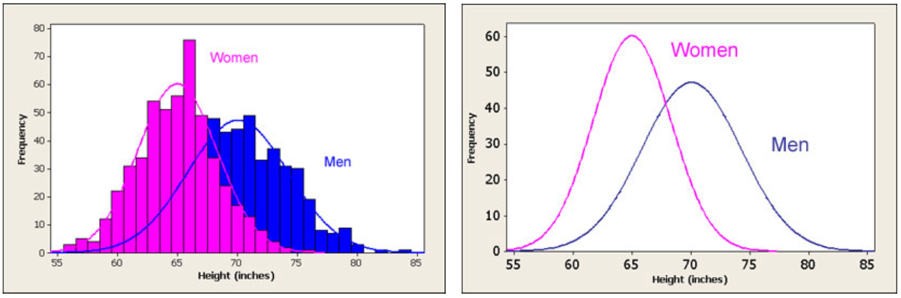
About Normal Distributions Again
The range of possible values is small enough. Most values are concentrated around the means.

Slide 10
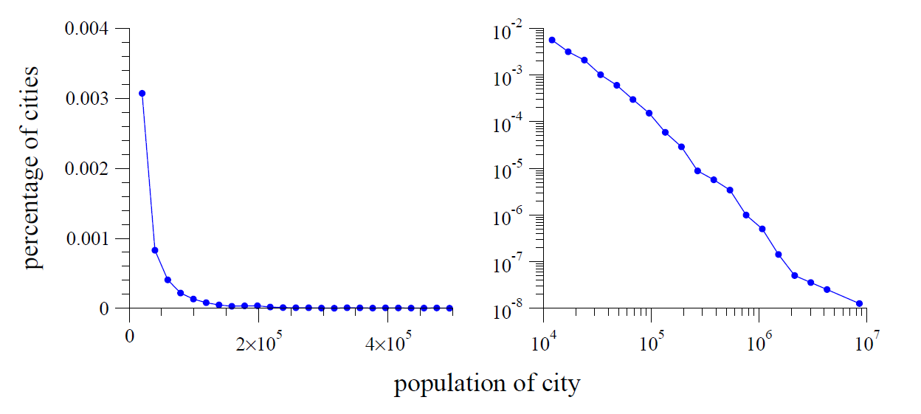
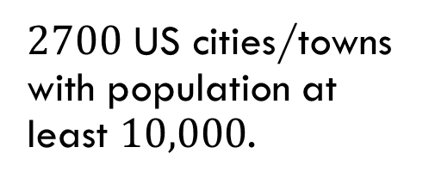

Example: City Populations (US Census, 2000)
$2700$ US cities/towns with population at least $10,000$.
$$α≈2.3$$
Key differences from normal distributions: a huge range of possible values and a long tail.

Slide 11
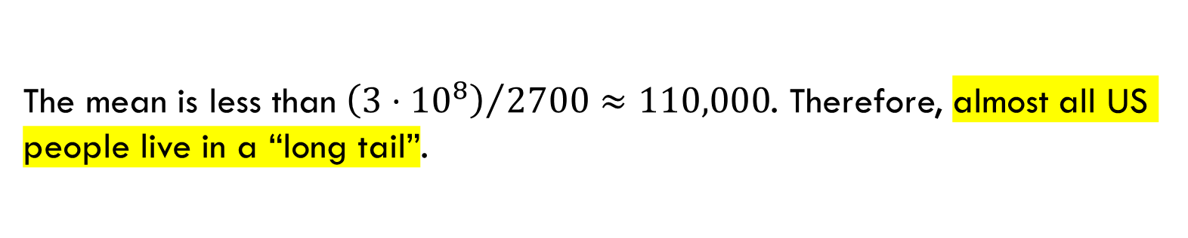
Long Tail
mean
The mean is less than ${\left(3⋅{10}^{8}\right)}/{2700≈110,000}$. Therefore, almost all US people live in a “long tail”.

Slide 12
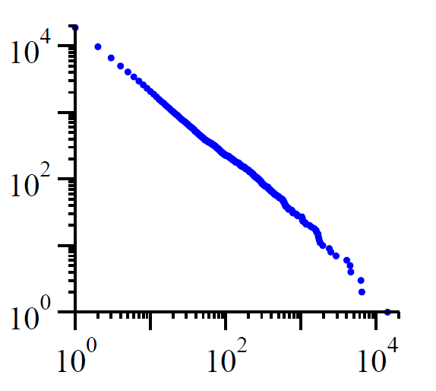
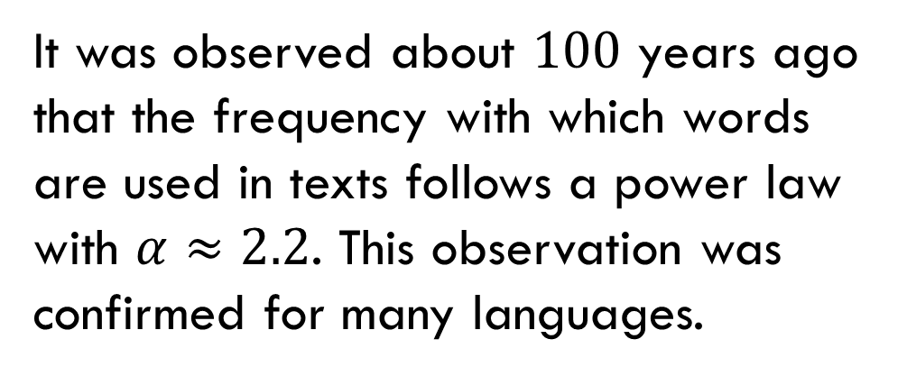
Another Example: Word Frequency
It was observed about $100$ years ago that the frequency with which words are used in texts follows a power law with $α≈2.2$. This observation was confirmed for many languages.
number of occurrences
Cumulative distribution of the numbers of occurrences of words in the novel Moby Dick by H. Melville. The horizontal axis shows the frequency rank of words.
rank

Slide 13
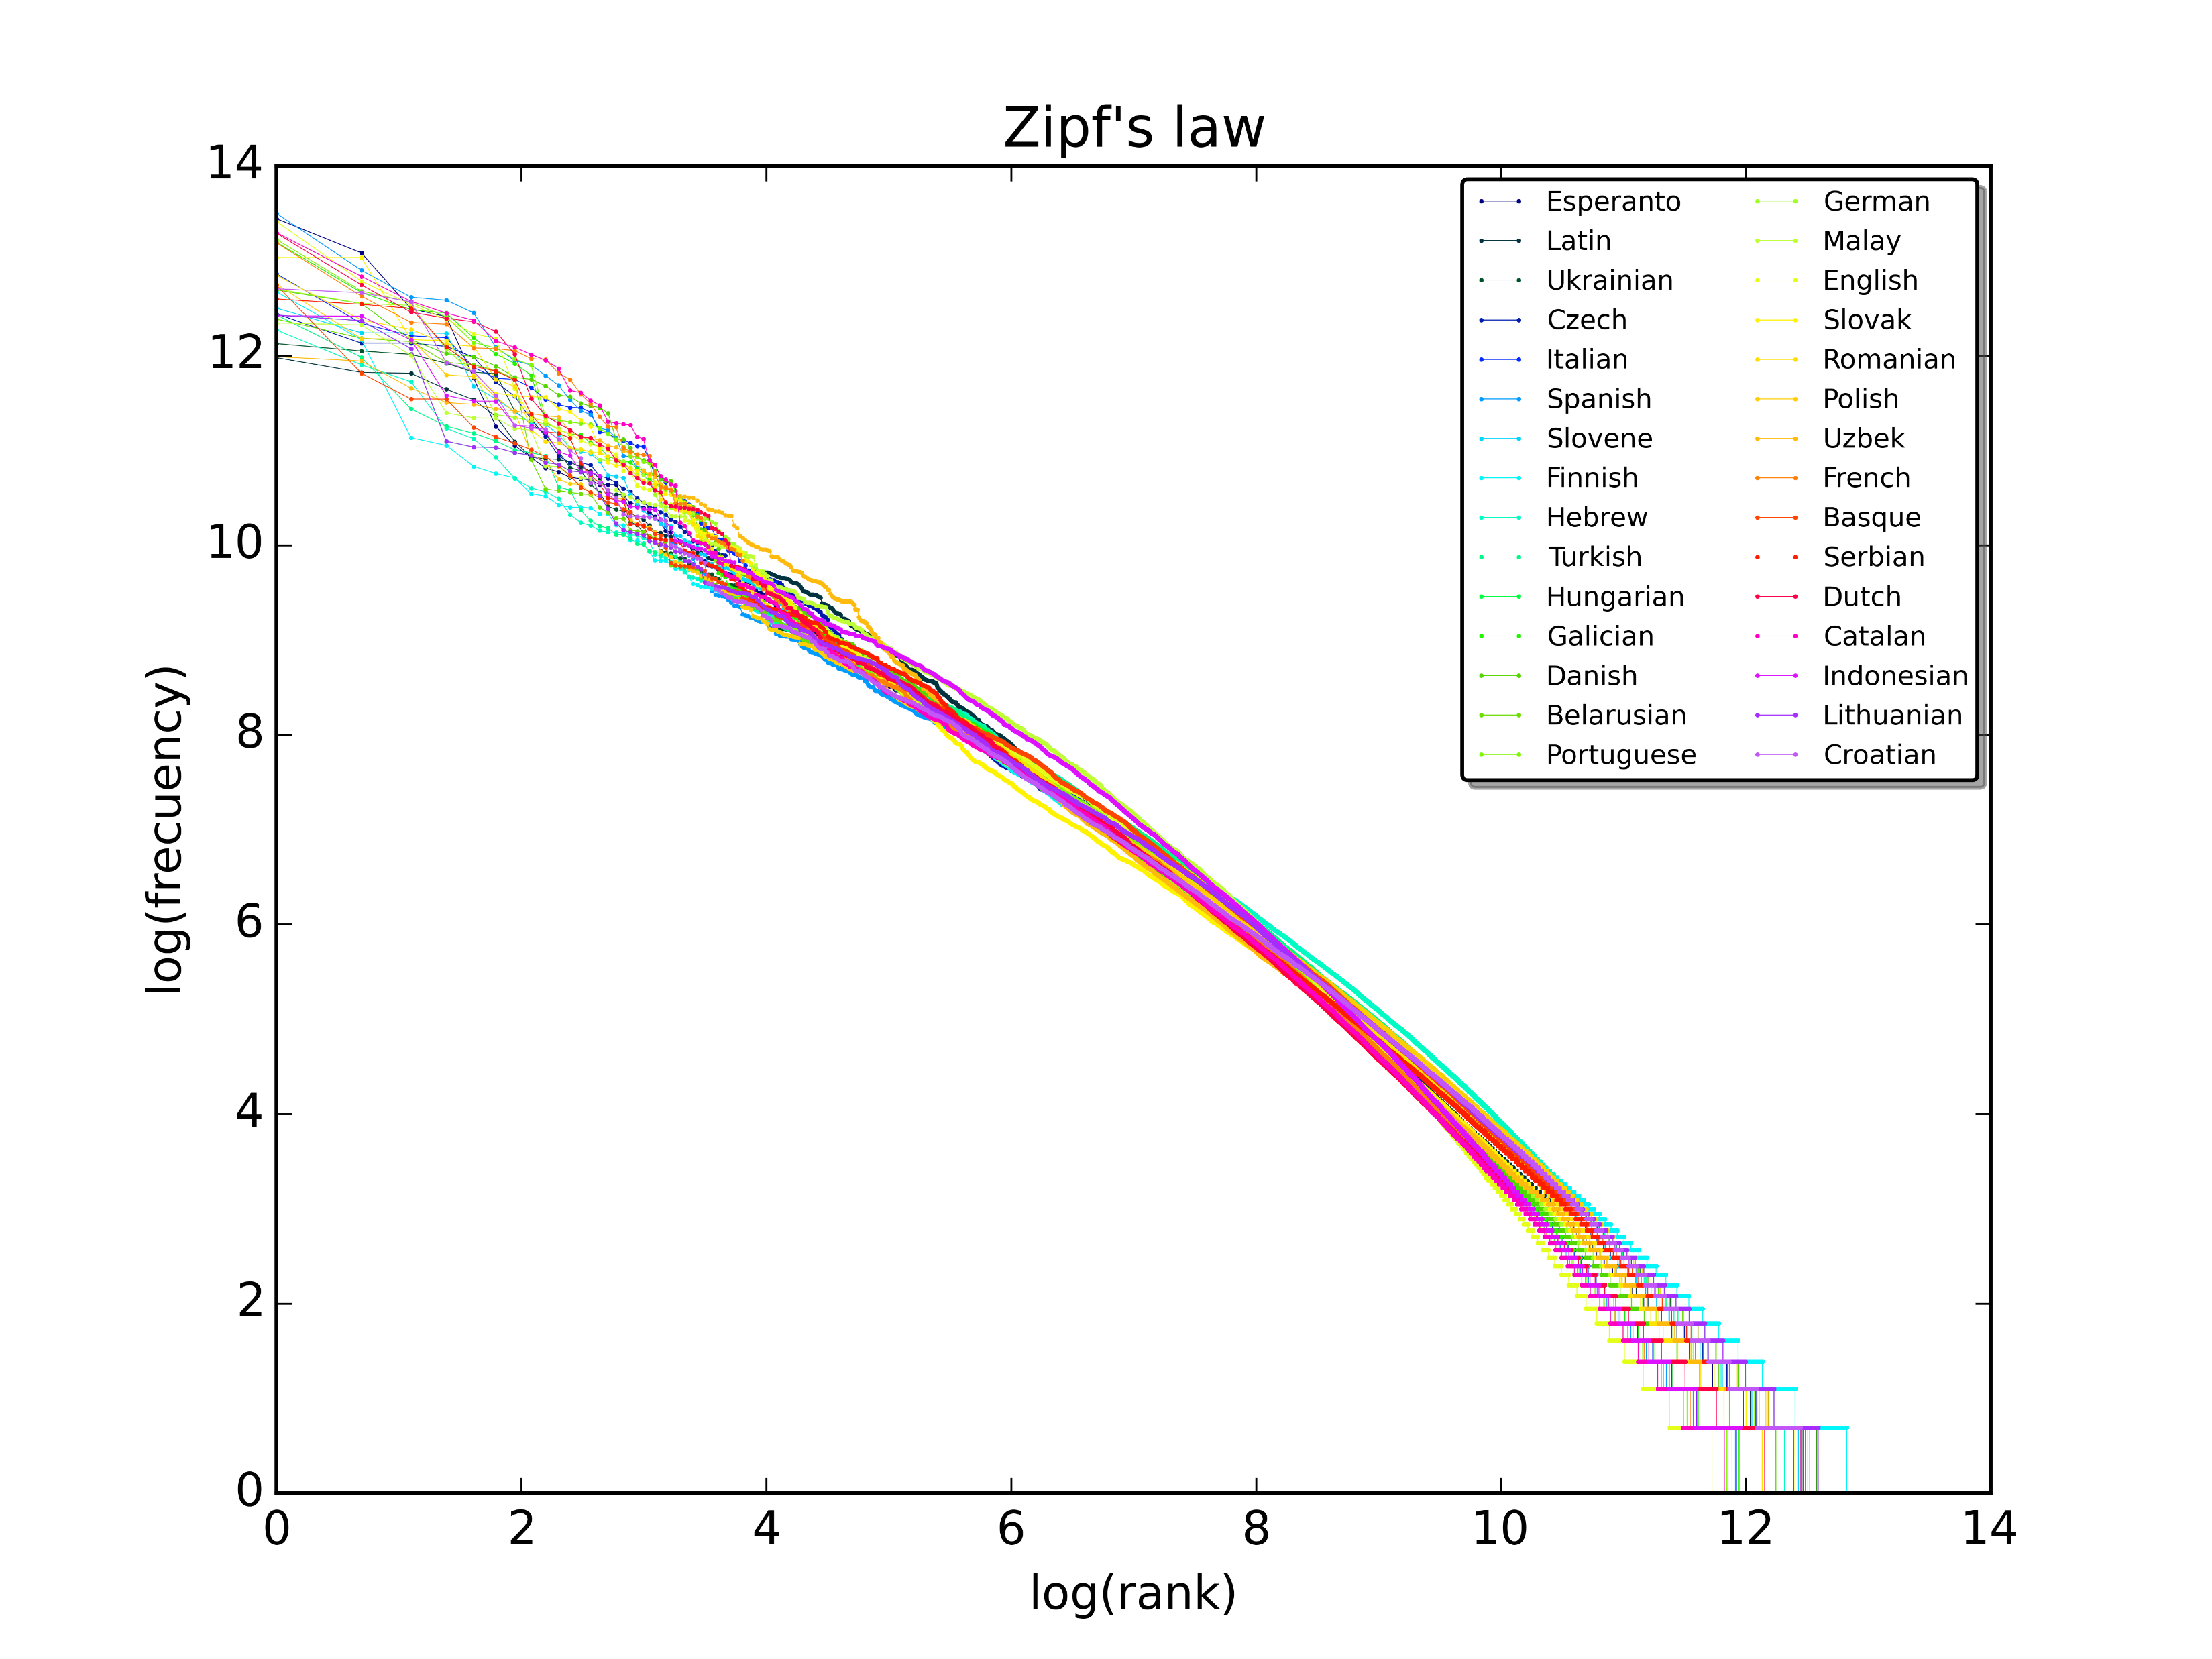
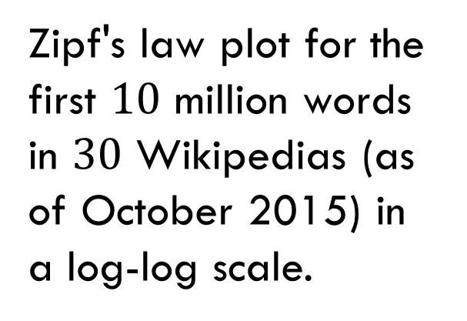
Another Example
Zipf's law plot for the first $10$ million words in $30$ Wikipedias (as of October 2015) in a log-log scale.

Slide 14
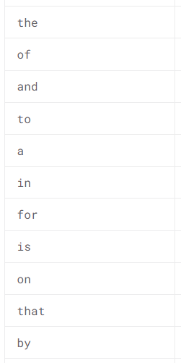
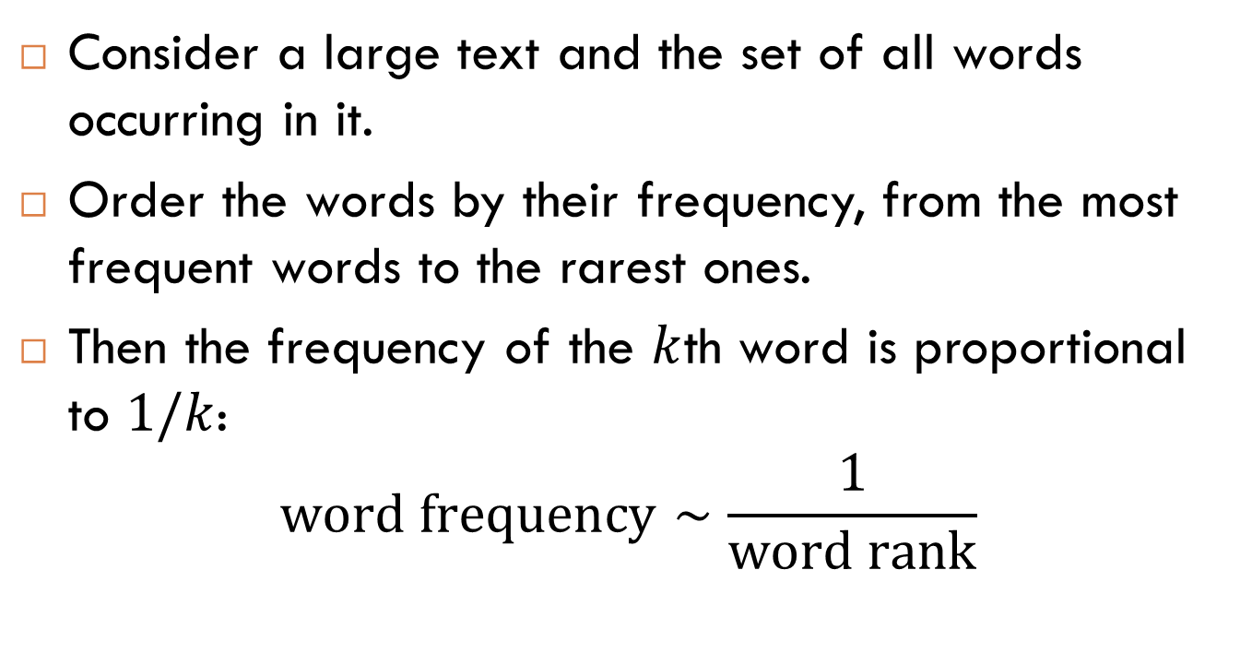
Zipf’s Law
Consider a large text and the set of all words occurring in it.
Order the words by their frequency, from the most frequent words to the rarest ones.
Then the frequency of the $k$th word is proportional to $1/k$:
$$\text{word} \text{frequency}∼\frac{1}{\text{word} \text{rank}}$$

Slide 15
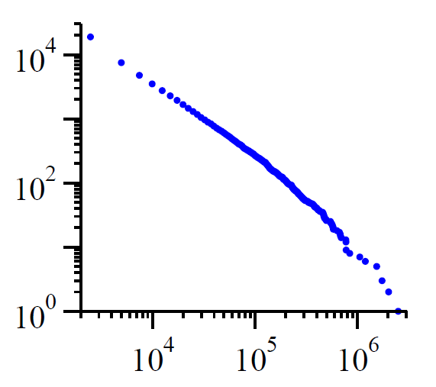

Similar Example
number of occurrences
Frequencies of family names
Cumulative distribution of the numbers of occurrences in the list of 89,000 common family names (US Census, 1990). Similar distributions are observed for family names in some other cultures as well.
$$α≈1.94$$
rank

Slide 16
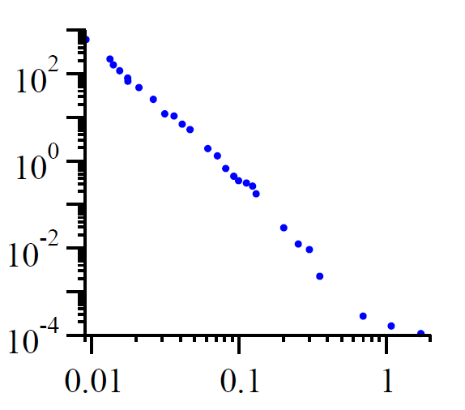

Example from Science
Frequencies of craters on the moon
Cumulative distribution that shows how the numbers of moon craters depends on their sizes.
number of craters per square kilometer
$$α≈3.14$$
crater diameter in km

Slide 17
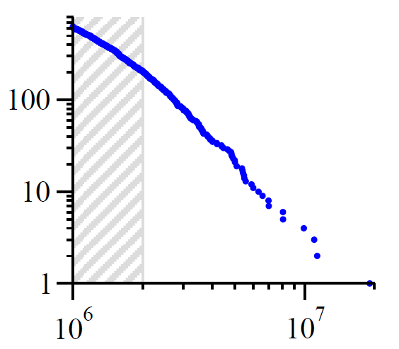
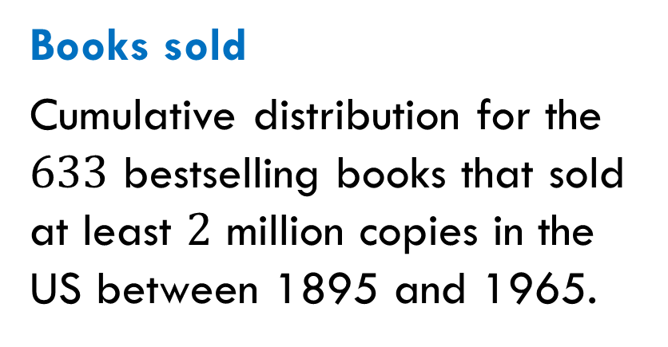

Example from Business
number of books
Books sold
Cumulative distribution for the $633$ bestselling books that sold at least $2$ million copies in the US between 1895 and 1965.
$$α≈3.51$$
number of copies sold
Notes:
The best selling book during the period covered was Benjamin Spock’s The Common Sense Book of Baby and Child Care. (The Bible, which certainly sold more copies, is not really a single book, but exists in many different translations, versions and publications, and was excluded by Hackett from her statistics.)
Data in the shaded regions were excluded from the calculations of the exponent in Table I.

Slide 18
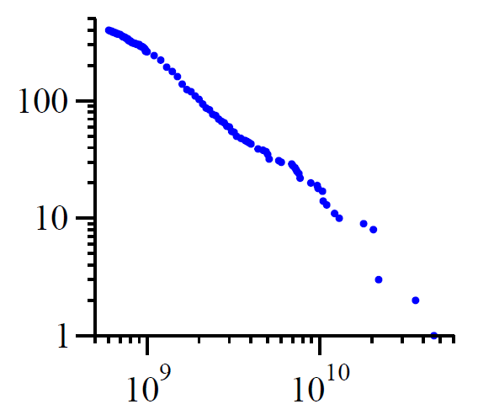
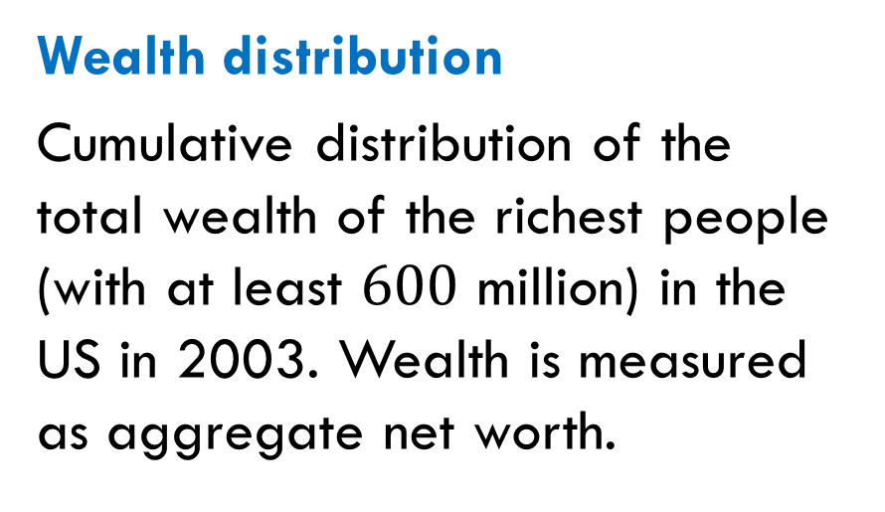

Example from Economics and Finance
number of people
Wealth distribution
Cumulative distribution of the total wealth of the richest people (with at least $600$ million) in the US in 2003. Wealth is measured as aggregate net worth.
$$α≈2.09$$
total wealth in dollars

Slide 19

Power Laws and the $80/20$ Rule

Slide 20
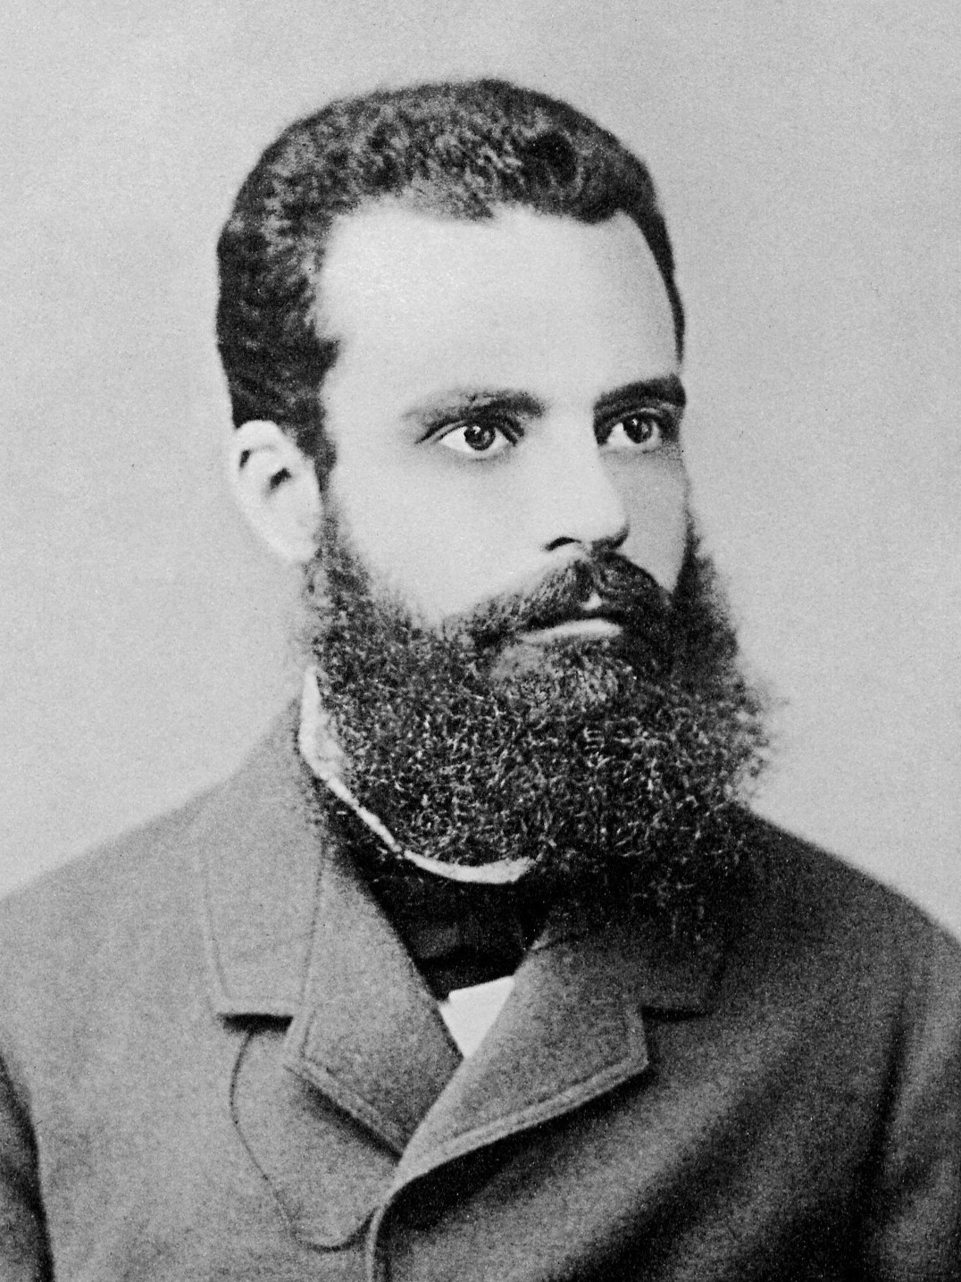

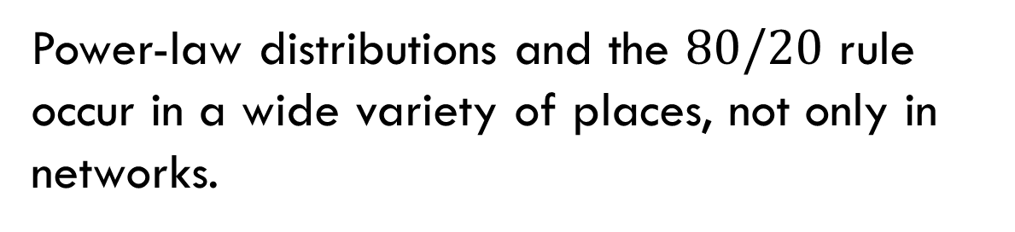
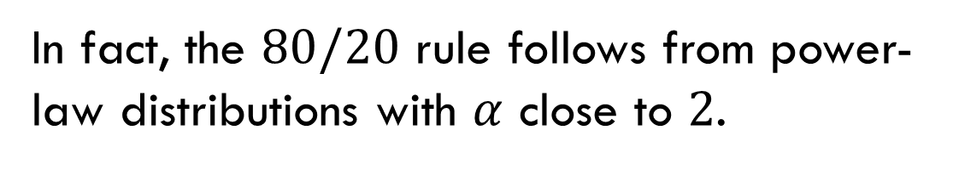
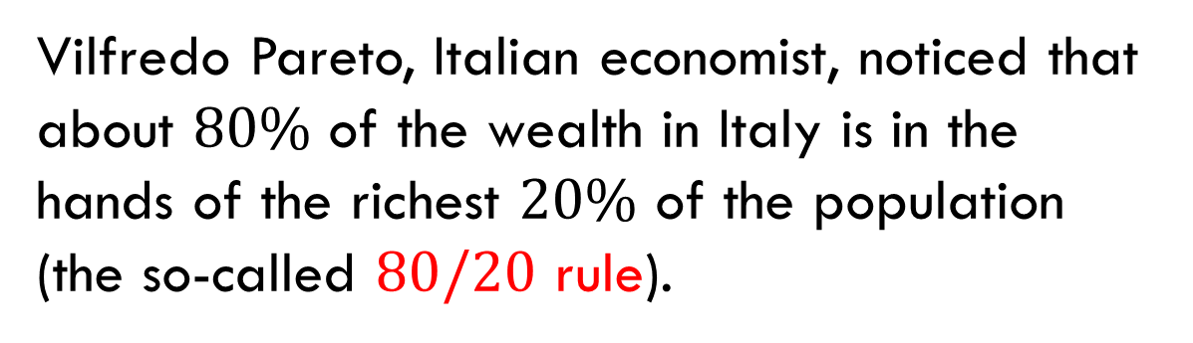
The $80/20$ Rule
Vilfredo Pareto, Italian economist, noticed that about $80\%$ of the wealth in Italy is in the hands of the richest $20\%$ of the population (the so-called $80/20$ rule).
In fact, the $80/20$ rule follows from power-law distributions with $α$ close to $2$.
Power-law distributions and the $80/20$ rule occur in a wide variety of places, not only in networks.
Vilfredo Pareto
1848-1923

Slide 21
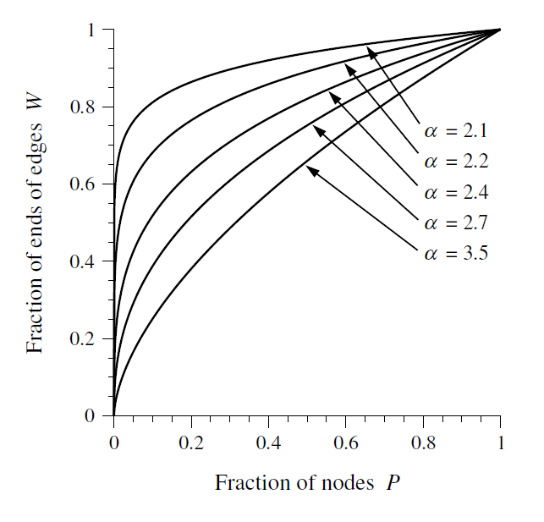
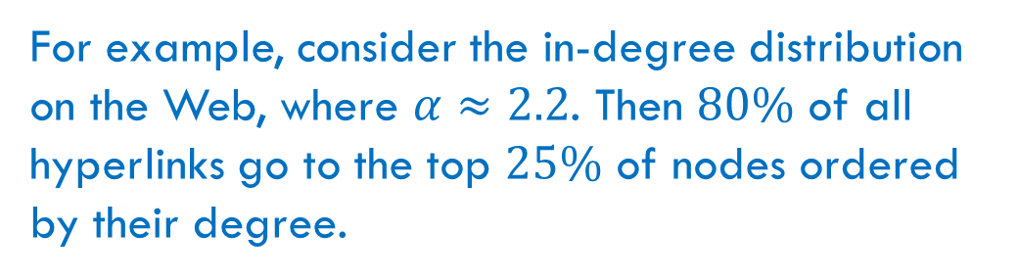
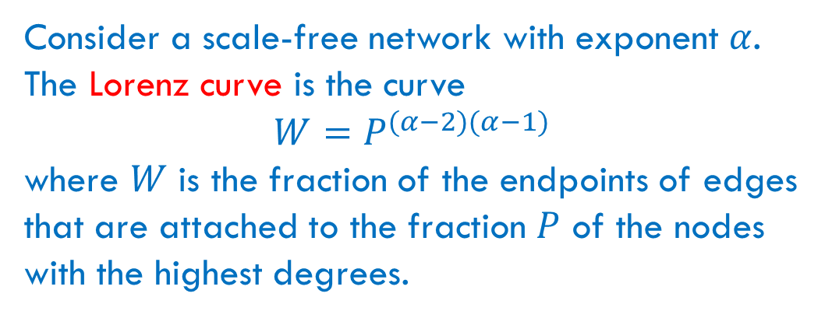
Lorenz Curves
Consider a scale-free network with exponent $α$. The Lorenz curve is the curve
$$W=P^{(α−2)(α−1)}$$
where $W$ is the fraction of the endpoints of edges that are attached to the fraction $P$ of the nodes with the highest degrees.
For example, consider the in-degree distribution on the Web, where $α≈2.2$. Then $80\%$ of all hyperlinks go to the top $25\%$ of nodes ordered by their degree.
Notes:
Max Lorenz (1876-1959) was an American economist who developed the Lorenz curve.

Slide 22
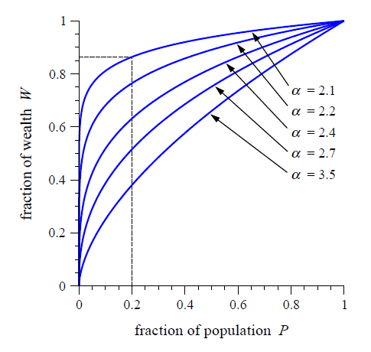
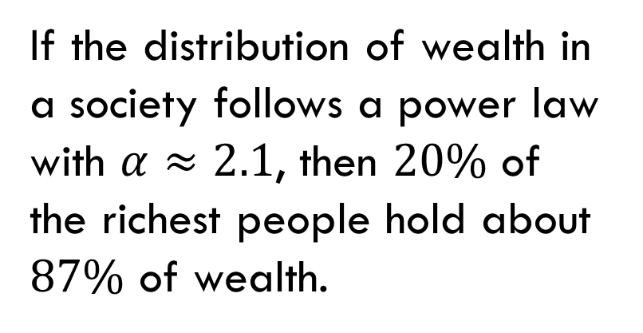
Distribution of Wealth
If the distribution of wealth in a society follows a power law with $α≈2.1$, then $20\%$ of the richest people hold about $87\%$ of wealth.

Slide 23
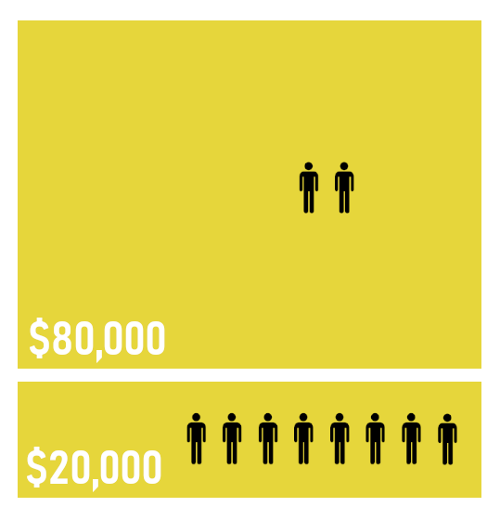
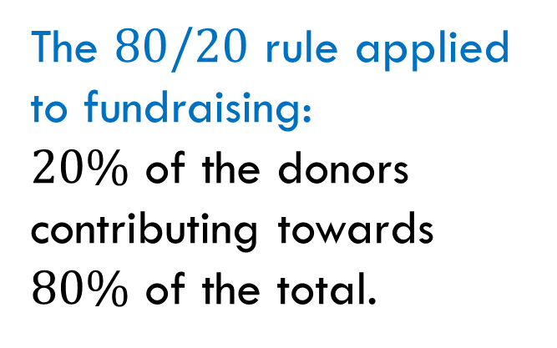
Another Examples
The $80/20$ rule applied to fundraising:
$20\%$ of the donors contributing towards $80\%$ of the total.

Slide 24
Power Laws for Other Centrality Measures

Slide 25
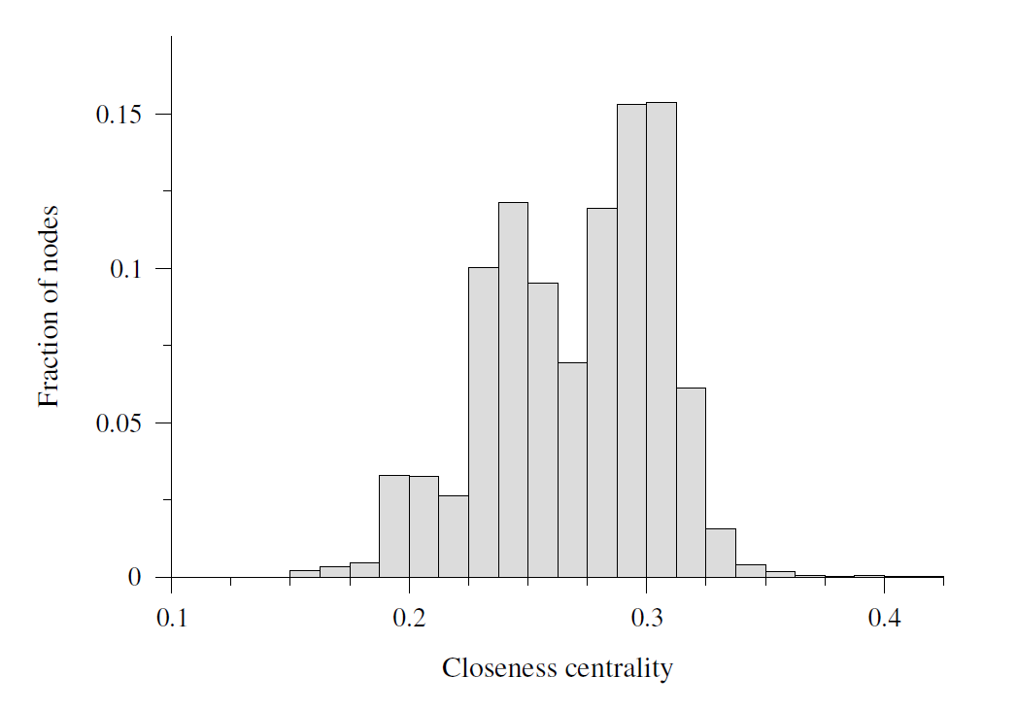
Closeness on the Internet
Not a power law
The closeness distribution does not follow a power law: it does not have a broad range and a long tail. The distribution is closer to a normal distribution.

Slide 26
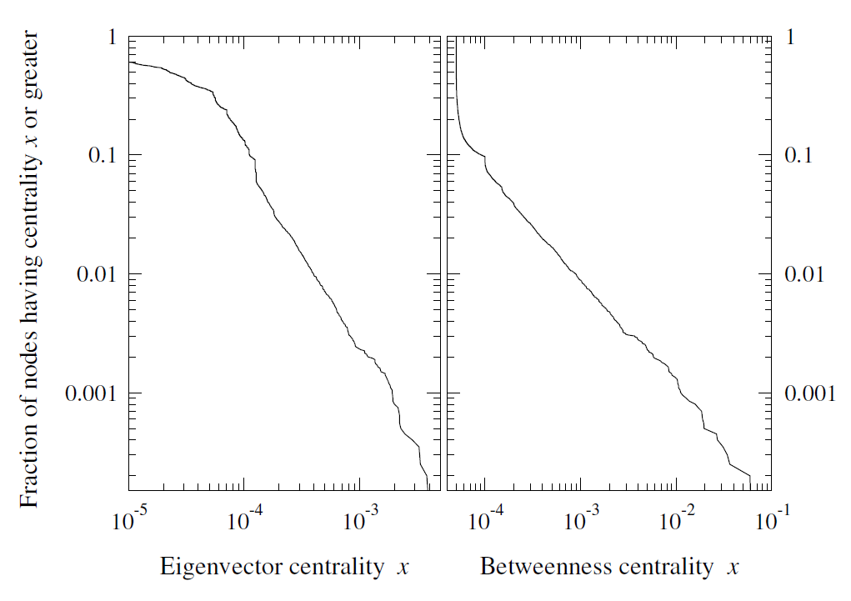
Eigenvector Centrality and Betweenness on the Internet
Power law
Both eigenvector centrality and betweenness centrality roughly follow a power law, at least in the tail of the distribution.

Slide 27
Popularity and Long Tail

Slide 28
Distributions of Popularity
Many power-law distributions can be viewed as distributions of popularity.
Examples
Degree distributions in social networks.
Degree distribution in transportation networks.
In-degree distributions in citation networks.
In-degree distributions in information networks like the Web.
Word frequency distributions in natural languages.
Name frequency distributions in countries.

Slide 29
Distributions of Popularity and Business
The distribution of popularity has important business consequences. For example, consider the distribution of popularity of books measured by the sale volume. Which of the following two options is more successful for the business of book sales?
Hits
Selling “hits”, a small number of extremely popular books that create large revenues.
Niche books
Selling “niche” books, a large number of unpopular books, each of which appeals to a small segment of the market.

Slide 30
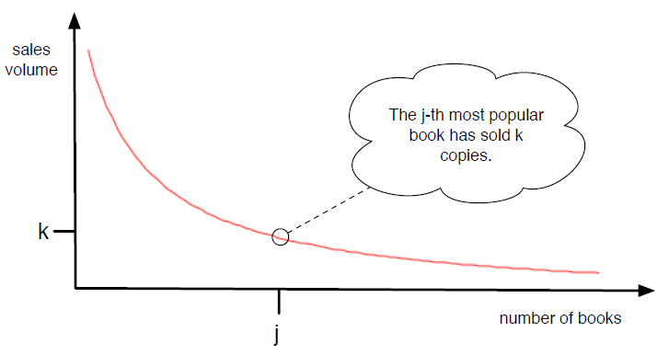
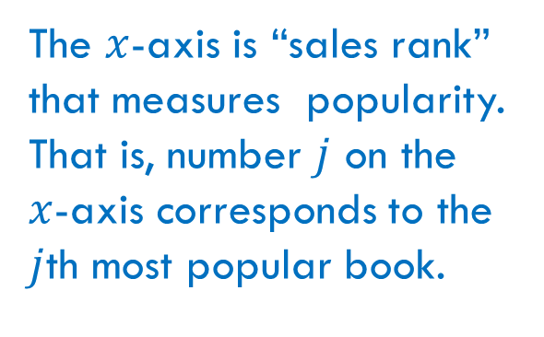
Distribution Curve
The $x$-axis is “sales rank” that measures popularity. That is, number $j$ on the $x$-axis corresponds to the $j$th most popular book.

Slide 31
Hits-Versus-Niche Question
The question can be stated in terms of the curve: which area is larger, the right part (hits) or the long tail (niche)?

Slide 32

Reading
Sections 10.4-10.5

